Slide 1
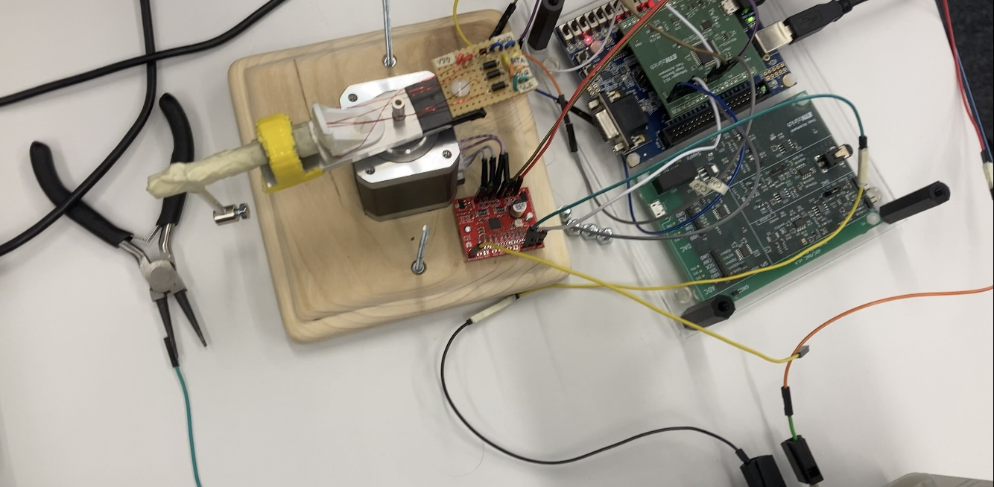
Furuta Pendulum
Marvin S., Nicola R.,
Basil F.
Electronics for Physicists II

Slide 2
Agenda
Project Overview
SSC Interface & Sensor
PID Loop
Drive Motor
Conclusion and Outlook

Slide 3
1. Project Overview
Goal: Build a real-time control system capable of stabilizing a mechanical arm.
Hardware Components:
FPGA (Calculations, Communication between Motor and Sensor)
Motor [Sanmotion F2]
Big Easy Driver (BED)
GMR-Based Angle Sensor [TLE5012B]
Software Components:
Connector
SSC Interface
PID Loop
Driver
APB Bus (from exercises)
Notes:
GMR = Giant MagnetoResistance

Slide 4
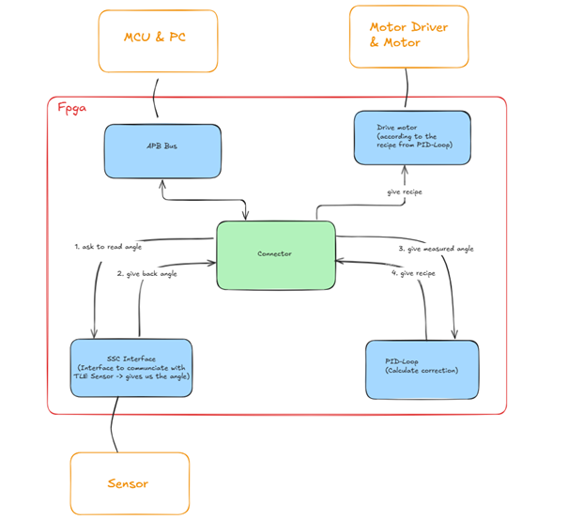
1. Project Overview

Slide 5
2. SSC Interface & Sensor
SSC: Synchronous Serial Communication (Protocol used by Infineon for their TLE5012B magnetic sensor)
Synchronous: FPGA and sensor share the same clock (they agree on when a bit is valid)
Serial: bits travel one at a time over a single wire, rather than all at once in parallel.
Purpose: Common protocol for angles between sensor and FPGA.
The three physical signals:
“sck_o”: Serial Clock, generated by the FPGA.
“data_pin”: single wire that carries all actual information. It is bidirectional: The same physical wire is used in both directions, but never simultaneously.
“csq_o”: Tells the sensor when a transaction is beginning and when it is ending. Active low, held low for the entire transaction.

Slide 6
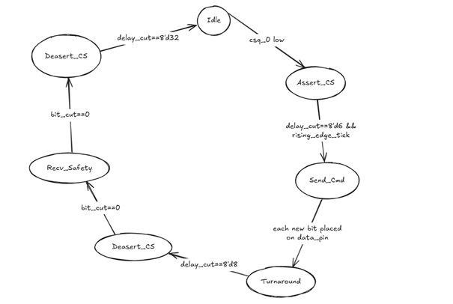
2. SSC Interface & Sensor – State Diagram

Slide 7
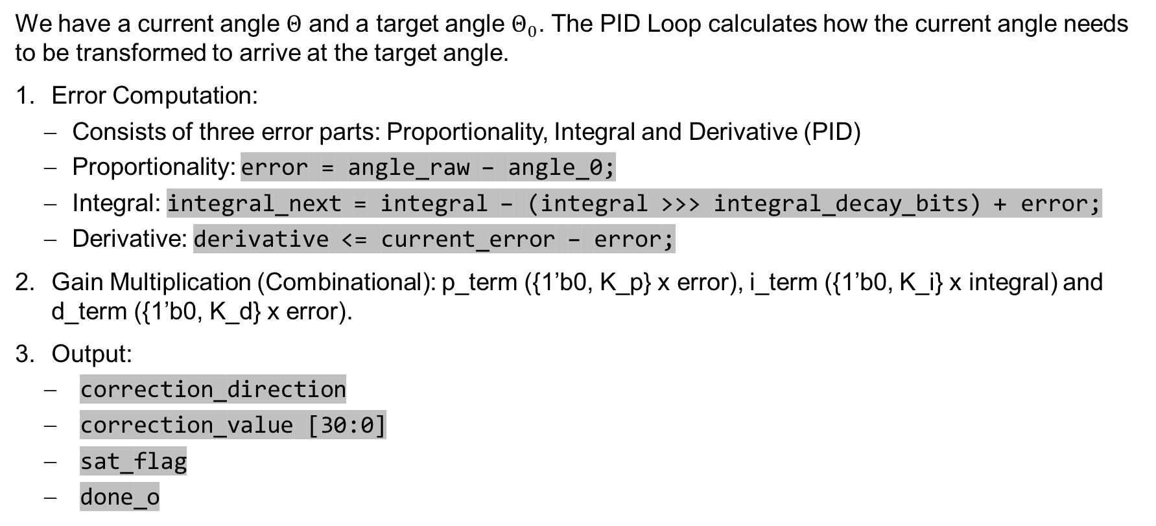
3. PID Loop
We have a current angle $Θ$ and a target angle $Θ_{0}$. The PID Loop calculates how the current angle needs to be transformed to arrive at the target angle.
Error Computation:
Consists of three error parts: Proportionality, Integral and Derivative (PID)
Proportionality: error = angle_raw – angle_0;
Integral: integral_next = integral – (integral >>> integral_decay_bits) + error;
Derivative: derivative <= current_error – error;
Gain Multiplication (Combinational): p_term ({1’b0, K_p} x error), i_term ({1’b0, K_i} x integral) and d_term ({1’b0, K_d} x error).
Output:
correction_direction
correction_value [30:0]
sat_flag
done_o

Slide 8
4. Drive Motor
The Big Easy Driver (BED) is the power electronics interface between the FPGA and the stepper motor. It converts simple instructions from the FPGA into the coils’ current signal required to rotate the stepper motor.
The FPGA only needs to send two signals: STEP (one pulse = one step) and DIR (high: CCW, low: CW)
We do this by setting the frequency of STEPs
Power supply of the motor:
Motor Voltage: 24 V DC

Slide 9
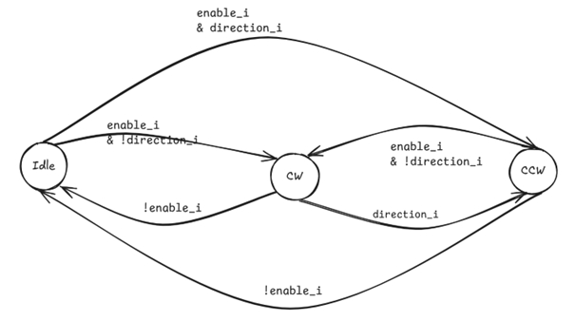
4. Motor Driver

Slide 10
5. Conclusion and Outlook
The project offered an interesting and manifold challenge.
It included not only coding, but also engineering tasks.
Many things had to be tested and determined empirically (such as constants from PID loop).
We learned a lot ☺

Slide 11
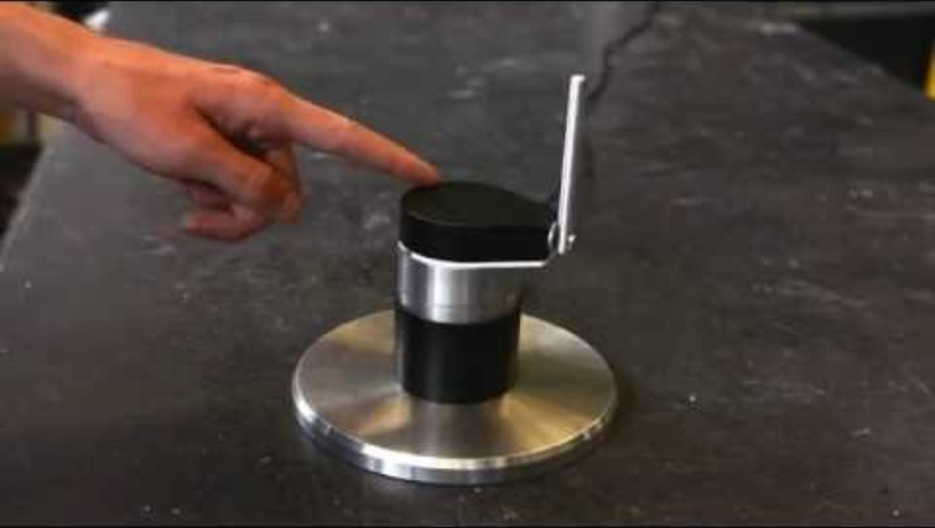
Demonstration from YouTube
Source: Ben Katz (YouTube)

